Slide 1
Indian Values (on the conceptual framework of vedas):
Purushartha and Nishkama karma

Slide 2
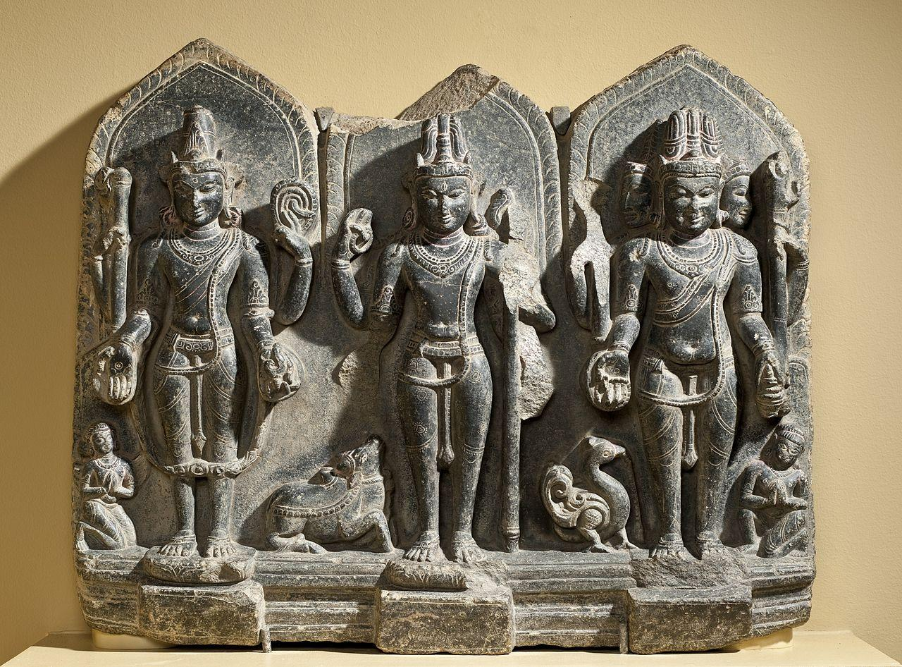
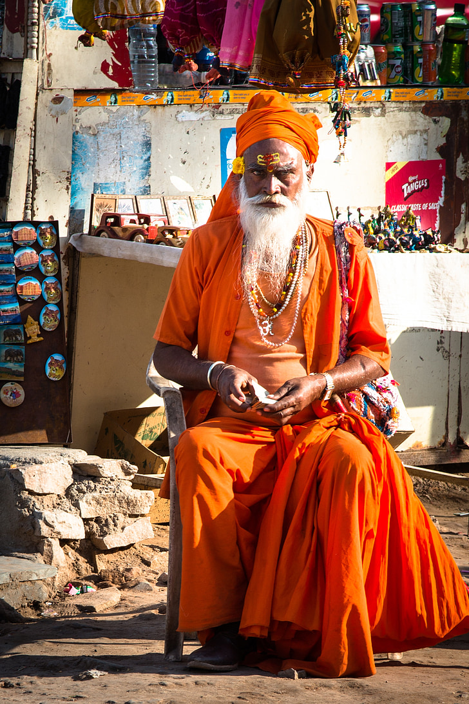
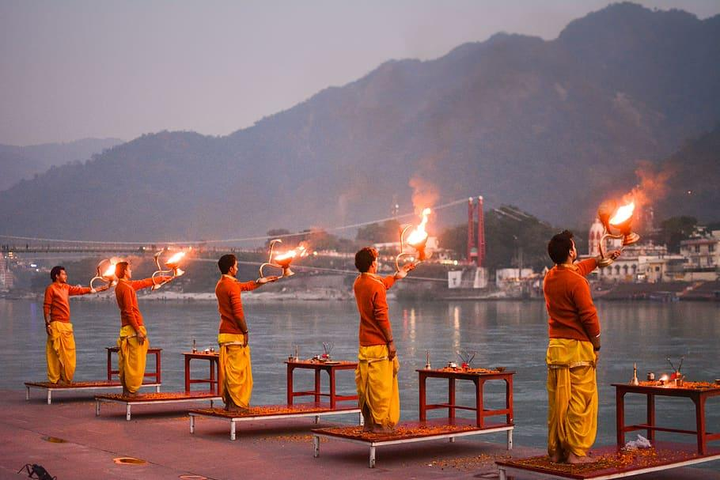

An overview
AN overwiew

Slide 3
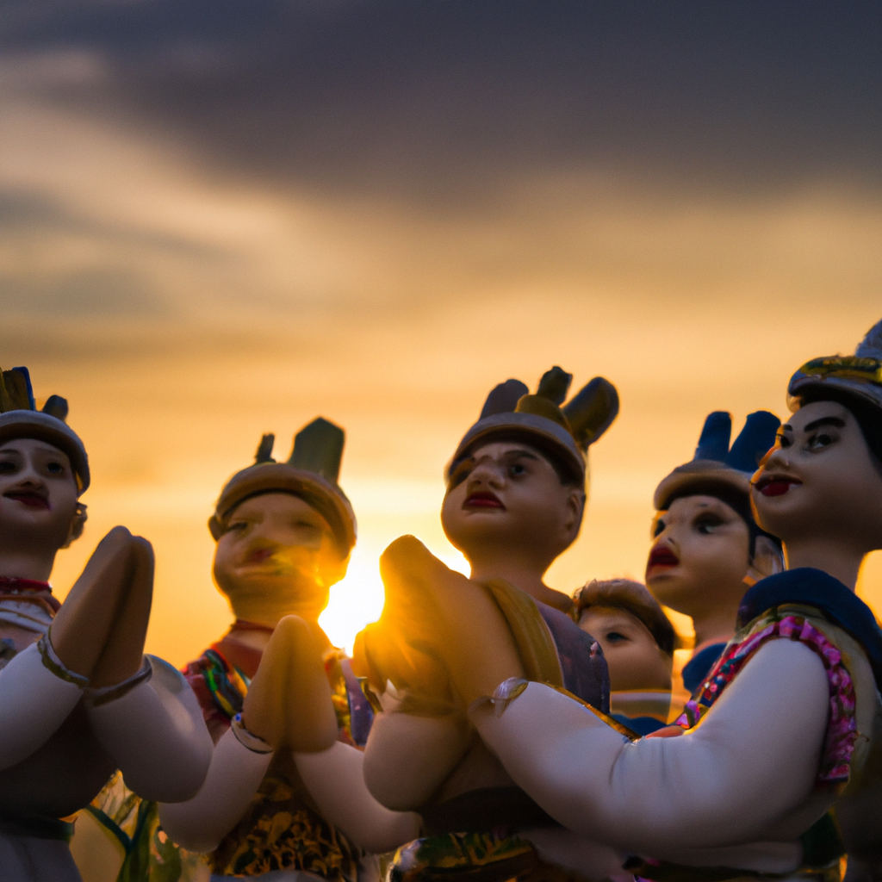

vedas
The Vedas, meaning “knowledge,” are the oldest texts of Hinduism.
They are derived from the ancient Indo-Aryan culture of the Indian Subcontinent and began as an oral tradition that was passed down through generations before finally being written in Vedic Sanskrit between 1500 and 500 BCE (Before Common Era).
The Vedas are structured in four different collections containing hymns, poems, prayers, and religious instruction.

Slide 4
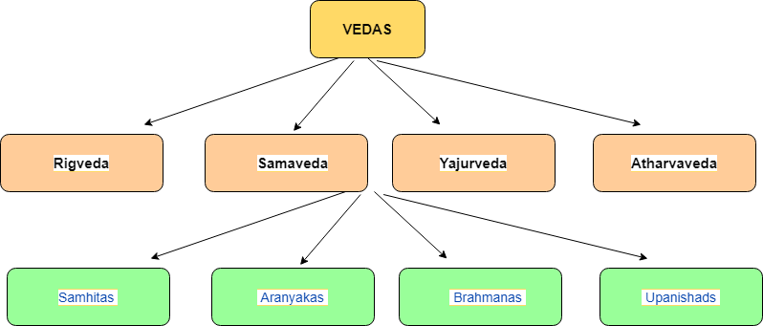

Slide 5
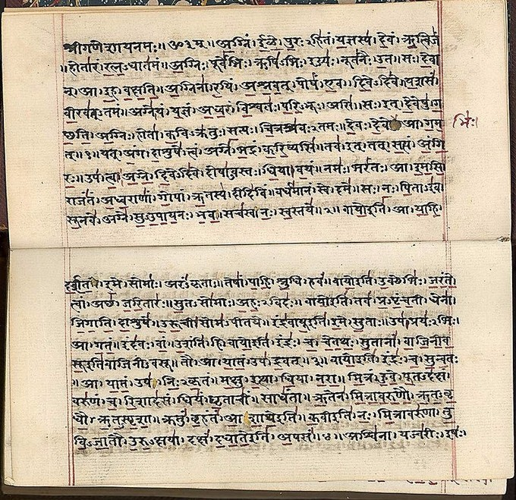
Rigveda Manuscript.

Slide 6
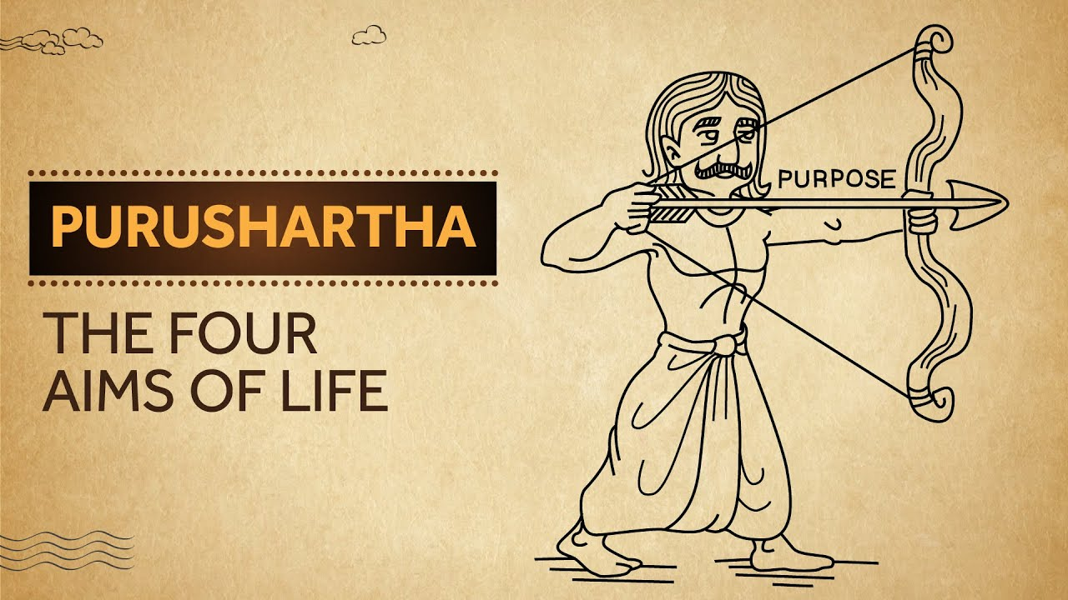

Slide 7


PURUSHARTHA = PURUSHA + ARTHA
Purusha means human being and Artha means purpose or an objective.
Purushartha means objectives of a person or a human being.

Slide 8
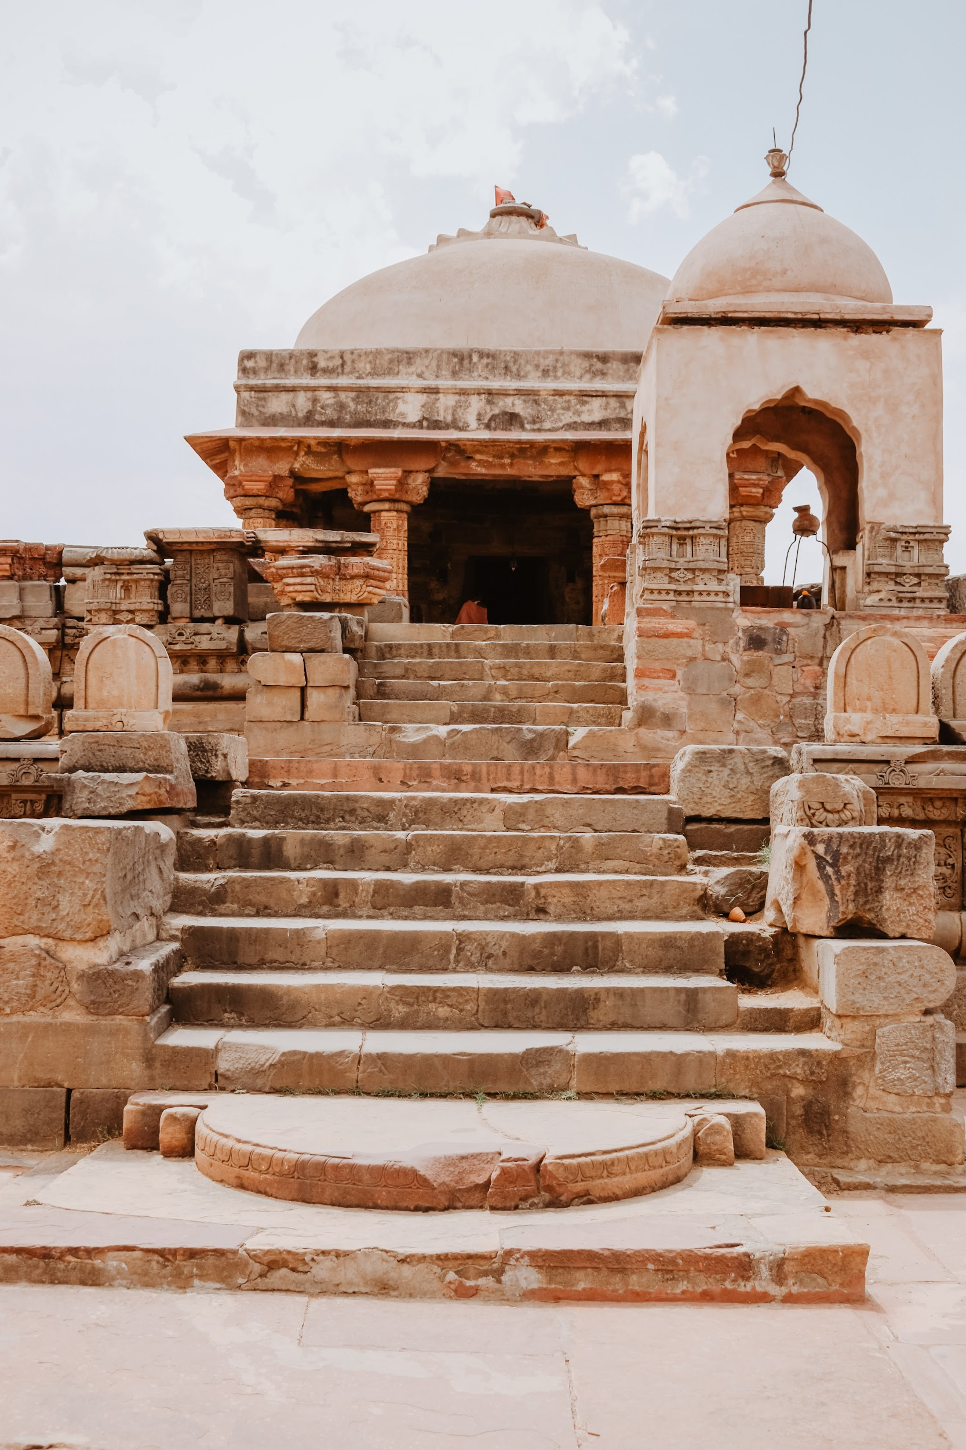
Four Aims of human life.
Dharma
Artha
Kama
Moksha

Slide 9
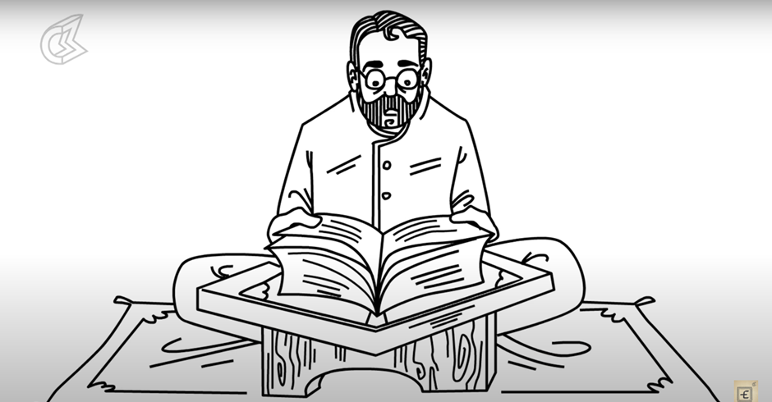
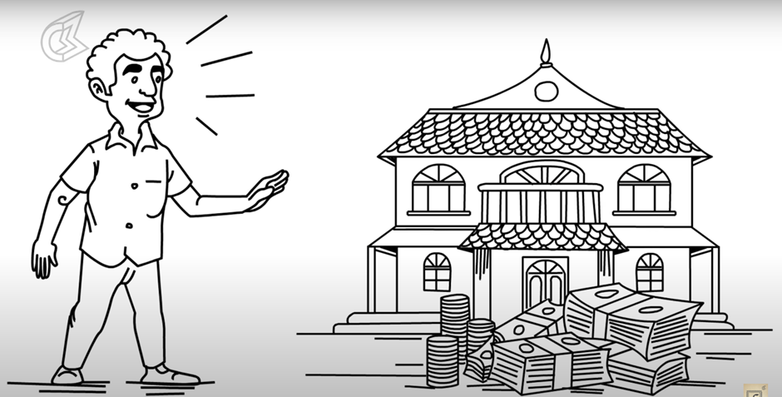
DHARMA
ARTHA
Right way of living
Religious Duties
Moral Rights
Prosperity
Economic Values
Career

Slide 10
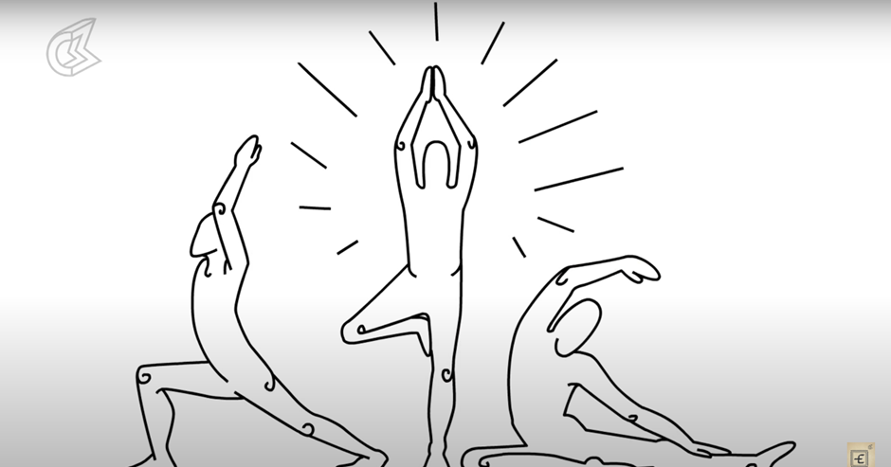
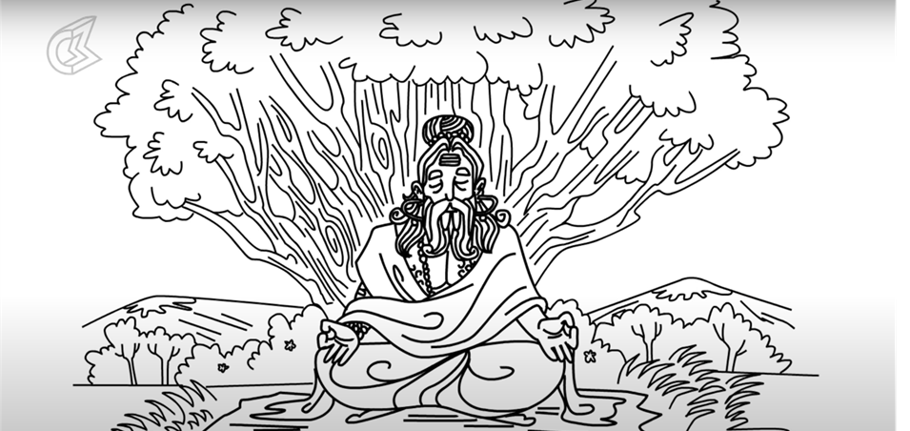
KAMA
MOKSHA
Desire
Passion
Aesthetic enjoyment of life
Liberation or release
Freedom
Self Realization

Slide 11

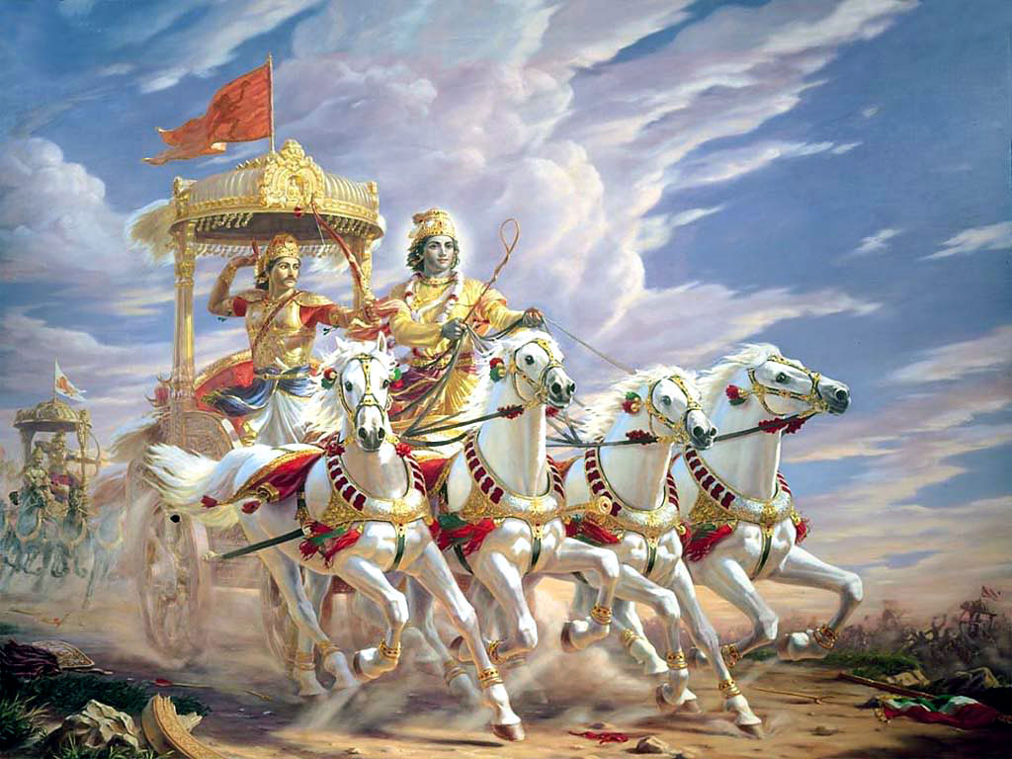
Its relevance acc to hindu mythology
"trivarga" or "three categories" of possible human pursuits
concept of mokṣa appears in the Upanishads
Concept of nishkama karma

Slide 12
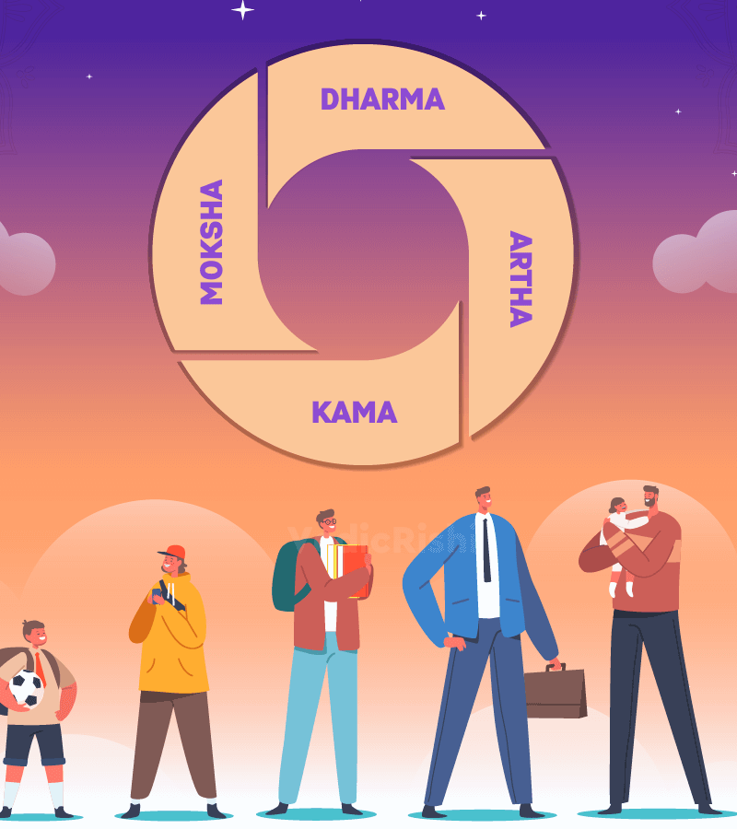
How can we inculcate it professionally & personally?
Being conscious in your actions, words, and thoughts.
Do work that is compatible to your nature and capabilities.
Having compassion and sensitivity to the needs of others.
Self-inquiry practice to find balance with four aims of life.

Slide 13
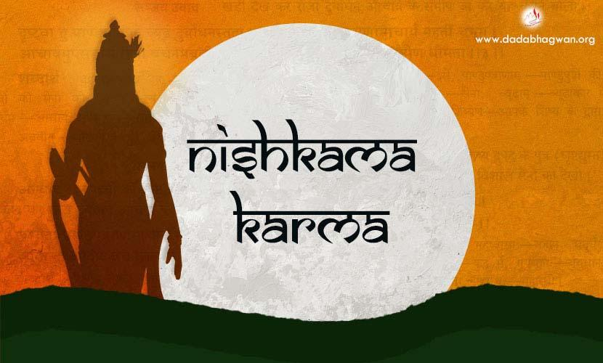

Slide 14
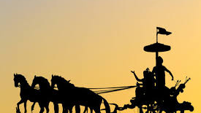
ORIGIN AND MEANING
❖Nishkama karma is the prominent theme of Bhagavad Gita. It is also considered as the essence or the central message of Bhagavad Gita.
❖It can be described as self-less or desire-less action which is performed without any expectation of fruit or result.

Slide 15
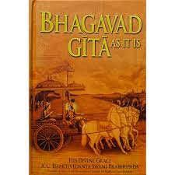
BHAGAVAD GITA VERSE
कर्मण्येवाधिकारस्ते मा फलेषु कदाचन |
❖The concern is with action done, never with the result. Let not the fruits of action be the motive.
❖Nishkama karma commands that a man should give up attachments to the motive, in order to be able to remain untroubled by success or failure of action.

Slide 16

Why is Nishkama karma necessary?
❖The central principle of practicing Nishkama Karma is mindfulness in the present moment.
❖This practice leads to calmness and composure as it allows practitioner to stay detached from results.
❖Minimum play of passion, jealousy , greed, hatred, anger etc.
❖In the long run it leads to cleansing of heart but also spiritual growth and holistic development.

Slide 17

Purusartha and Nishkam Karma in Today’s World
Purusharth and Nishkama karma has found many modern advocates
In the modern business area, the emphasis has shifted to ethical business practices and intrinsic human values
Stepping beyond personal goals and agendas while pursuing any action over greater good,

Slide 18
Purusartha and Nishkam Karma in Today’s World
Practicing Nishkama Karma reduces stress at workplace
As work has been turned into a pursuit of personal excellence, which results in greater personal satisfaction
Minimum play of passion, jealousy , greed, hatred, anger etc.

Slide 19
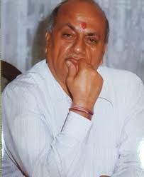
Kumar Bihari Pandey
(Industrialist, Philanthropist, Educationalist, Writer…
A multi faceted self made man)

Slide 20
Kumar Bihari Pandey
Born: 7Th March 1936 in Siwan, Bihar
In 1962 joined Bombay Tools and Dye Company as watchman
23rd March 1968: Established ‘Sunita Engineering Works’
Sunita Engineering works is Sunita Group of Companies now prospering day by day

Slide 21

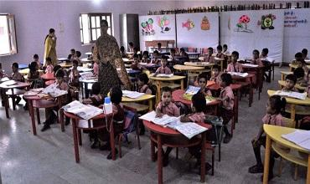
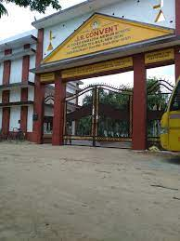
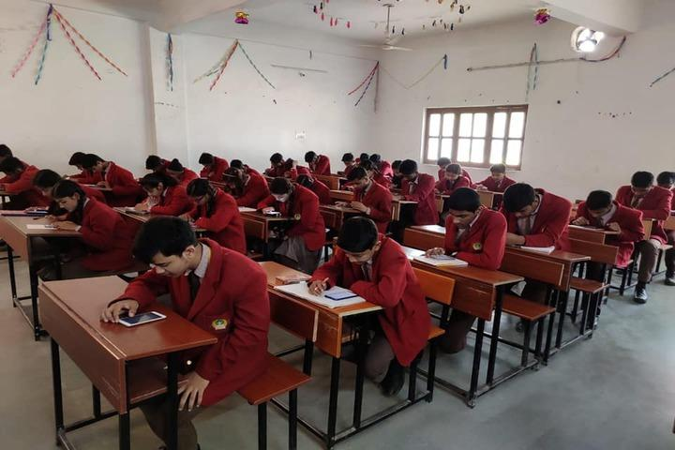
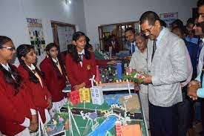

Reforming lives …..

Slide 22


Conclusion

Slide 23
THANK YOU!

